Slide 1

IMPACT OF CAR FEATURE ON PRICE AND PROFITABILITY ANALYSIS
PROJECT BY DEBARATI CHATTERJEE

Slide 2
PROJECT DESCRIPTION
The automotive industry has been rapidly evolving over the past few decades, with a growing focus on fuel efficiency, environmental sustainability, and technological innovation. With increasing competition among manufacturers and a changing consumer landscape, it has become more important than ever to understand the factors that drive consumer demand for cars.
In recent years, there has been a growing trend towards electric and hybrid vehicles and increased interest in alternative fuel sources such as hydrogen and natural gas. At the same time, traditional gasoline-powered cars remain dominant in the market, with varying fuel types and grades available to consumers.
For the given dataset, as a Data Analyst, the client has asked How can a car manufacturer optimize pricing and product development decisions to maximize profitability while meeting consumer demand? This problem could be approached by analysing the relationship between a car's features, market category, and pricing, and identifying which features and categories are most popular among consumers and most profitable for the manufacturer. By using data analysis techniques such as regression analysis and market segmentation, the manufacturer could develop a pricing strategy that balances consumer demand with profitability, and identify which product features to focus on in future product development efforts. This could help the manufacturer improve its competitiveness in the market and increase its profitability over time.

Slide 3
APPROACH
I spent some time familiarizing myself with the data before commencing the analysis. Examine the data structure to obtain a feel of the overall content. This allows me to identify any potential concerns or obstacles that I may encounter while I do my analysis.
I check for any null values or missing data in the dataset, and clean the rows containing blank cells.
When I finish my data analysis, I present my insights to the audience in a clear and concise manner. I use advance excel concept such as pivoting, regression analysis, conditional formatting and utilize visuals like charts and graphs to help me express my findings.
I constructed dashboard with appropriate visuals, slicars to find insights from the dataset.

Slide 4



TECH-STACKED USED
To clean the data, analysis and summarise given dataset, visualize with appropriate graphs and find valuable insights
To present the report in structured manner.
To record the video presentation

Slide 5
DATA DESCRIPTION
The variables in the dataset are:
● Make: the make or brand of the car
● Model: the specific model of the car
● Year: the year the car was released
● Engine Fuel Type: the type of fuel used by the car (gasoline, diesel, etc.)
● Engine HP: the horsepower of the car's engine
● Engine Cylinders: the number of cylinders in the car's engine
● Transmission Type: the type of transmission (automatic or manual)
● Driven_Wheels: the type of wheels driven by the car (front, rear, all)
● Number of Doors: the number of doors the car has
● Market Category: the market category the car belongs to (Luxury, Performance, etc.)
● Vehicle Size: the size of the car
● Vehicle Style: the style of the car (Sedan, Coupe, etc.)
● Highway MPG: the estimated miles per gallon the car gets on the highway
● City MPG: the estimated miles per gallon the car gets in the city
● Popularity: a ranking of the popularity of the car (based on the number of times it has been viewed on Edmunds.com)
● MSRP: the manufacturer's suggested retail price of the car
The dataset contains information on various car models and their specifications, and is titled "Car Features and MSRP". It was collected and made available on Kaggle by Cooper Union, a private college located in New York City.
Here is a brief overview of the dataset:
● Number of observations: 11,159
● Number of variables: 16
● File type: CSV (Comma Separated Values)

Slide 6
DATA ANALYSIS
Link of Excel Work Book:
https://docs.google.com/spreadsheets/d/1PVGRMRK7zvidUekHucxmvFajd06IlfQJ/edit?usp=sharing&ouid=110345419604987102522&rtpof=true&sd=true

Slide 7
TASK-1
QUESTION:
How does the popularity of a car model vary across different market categories
INSIGHT:
Crossover market has maximum number of Car
1. Hatchback,Flex Fuel 2. Flex Fuel,Diesel 3. Crossover,Flex Fuel,Performance market has maximum popularity

Slide 8
TASK-2
QUESTION:
What is the relationship between a car's engine power and its price?
INSIGHT:
Car Price is positively correlated to Engine Horse Power.
The correlation coefficient (r)=0.661827
That is Car Price increase when engine horse power increase

Slide 9
TASK-3
QUESTION:
Which car features are most important in determining a car's price?
INSIGHT:
By Regression Analysis on Car Price it is found that No of cylinder in Engine has maximum impact on Car Price

Slide 10
TASK-4
QUESTION:
How does the average price of a car vary across different manufacturers?
INSIGHT:
Among manufacturer , Bugatti has highest average price $2757K followed by Maybach $546K and Rolls-Royce $351K

Slide 11
TASK-5
QUESTION :
What is the relationship between fuel efficiency and the number of cylinders in a car's engine?
INSIGHT:
Number of cylinder is negatively correlated with estimated miles per gallon (MPG). The correlation coefficient (r)= -0.62031
That is no of cylinder in engine decreases when fuel efficiency increases

Slide 12
DATA VISUALIZATION & DASHBOARD

Slide 13
TASK-1
QUESTION:
How does the distribution of car prices vary by brand and body style?
INSIGHT:
Coupe styled Ferrari has highest total price followed by coupe style Lamborghini. While 2dr Hatchback styled Audi has cheapest price

Slide 14
TASK-2
QUESTION:
Which car brands have the highest and lowest average MSRPs, and how does this vary by body style?
INSIGHT:
Bugatti has highest average price $1757K followed by Maybach $ 546K.Plymouth brand has lowest average price $3.12k. Average car price also varies from body style. Coupe and convertible styled car has high average price while regular car pickup has low average price

Slide 15
TASK-3
QUESTION:
How do the different feature such as transmission type affect the MSRP, and how does this vary by body style?
INSIGHT:
Automated Manual transmission typed with coupe styled car has maximum average price $245K where manual typed Passenger Van style car has minimum price $4K

Slide 16
TASK-4
QUESTION:
How does the fuel efficiency of cars vary across different body styles and model years?
INSIGHT:
Fuel efficiency of cars increases over years for almost every car except Cargo Van, Extended Car Pickup and Regular Car Pickup styled car

Slide 17
TASK-5
QUESTION:
How does the car's horsepower, MPG, and price vary across different Brands?
INSIGHT:
Car's horsepower is invertedly proportional to MPG ie, higher the HP lower the MPG and directly proportional to car price ie, higher the HP bigger the price bubble.

Slide 18
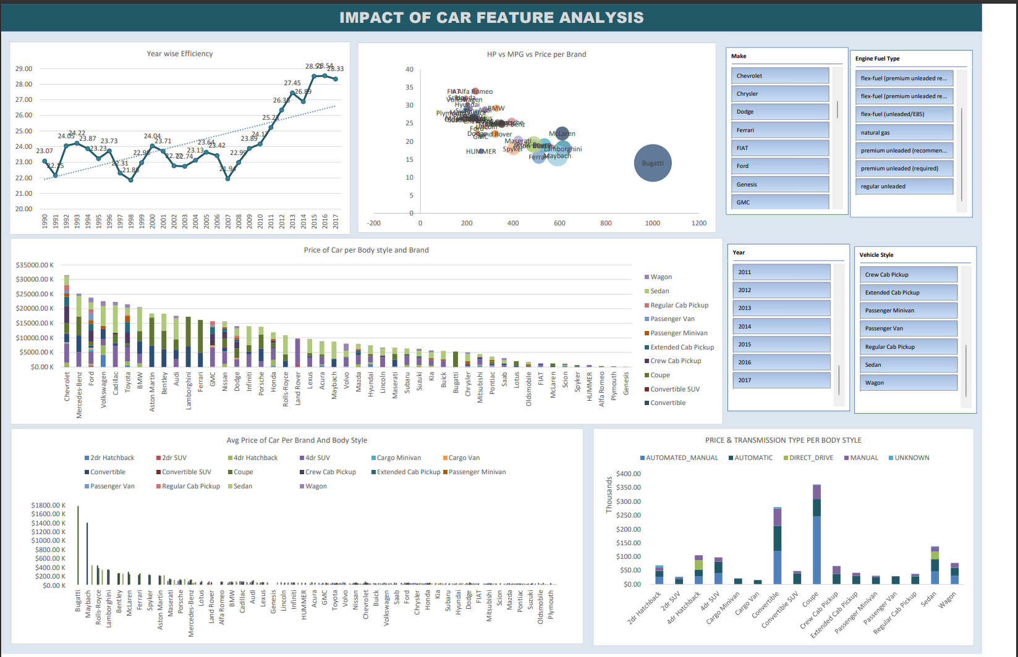
DASHBOARD

Slide 19
RESULT
Fuel Efficiency increased over the years and had been maximum in 2015-2016 time period.
Price of the car is directly proportional to Engine horse power and invertedly proportional to fuel efficiency.
Chevrolet car has maximum price among all the brands, while coupe styled car has maximum price.
Coupe styled Bugatti is highest priced car. Plymouth branded car has lowest average price.
Automated manual transmission typed car are costly.
In 2017 coupe styled Acura Branded car became costliest car.

Slide 20
CONCLUSION
This project has helped me to learn data cleaning, data manipulation and further data visualization on real life data set.
I get the opportunity to explore Microsoft Excel in a larger level which helped me to level up my Excel skill.
I learnt statistical analysis to find deeper insight from any dataset.
Further this project gives me an insight of car pricing and how different car features can effect car price and profitability.

Slide 21

THANK YOU

